Slide 1
Software Testing/QA & Selenium Testing Tools

Slide 2
Software Testing/QA

Slide 3
Agenda
Overview
(QA) Quality Assurance Standards
What do you mean by quality assurance?
How do we ensure quality?
QA role
Assigning roles and responsibilities
Getting deep into SDLC
Team Collaboration
Setting up goals and expectations
Look into Test Planning
Creating test strategy
Creating test plan
Writing acceptance criteria
Identifying when tests are complete

Slide 4
Various kinds of tests QA does
An Overview: Box testing
Introduction to Manual testing
UI automation testing in progress
An overview: Integration testing
An overview: Performance testing
An overview: Security testing
Reporting Bugs
Let us identify bugs
Reporting bugs
Bugs Triage
Communicating bugs to the team
Getting bugs fixed immediately
Bug bashes
Let us go ahead with Next steps

Slide 5
Overview
What is Quality?
Quality is defined as the product or services that should be "fit for use and purpose."
Quality is all about meeting the needs and expectations of customers concerning functionality, design, reliability, durability, and price of the product.
What is Assurance?
Assurance is a positive declaration on a product or service. It is all about the product which should work well.
It provides a guarantee which would work without any problem according to expectations and requirements.

Slide 6
What is Quality Assurance?
Quality Assurance is also known as QA Testing.
QA is defined as an activity to ensure that an organization is providing the best product or service to the customers.
Software Quality Assurance seems it is all about evaluation of software based on functionality, performance, and adaptability; however software quality assurance goes beyond the quality of the software, it also includes the quality of the process used to develop, test and release the software.
Software Quality assurance is all about the Software Development lifecycle that includes requirements management, software design, coding, testing, and release management.
Quality Assurance is the set of activities that defines the procedures and standards to develop the product.

Slide 7
Quality Assurance is a systematic way of creating an environment to ensure that the software product being developed meets the quality requirements. This process is controlled and determined at the managerial level.
It is a preventive process whose aim is to establish the correct methodology and standard to provide a quality environment to the product being developed.
Quality Assurance focuses on process standard, projects audit, and procedures for development. QA is also known as a set of activities designed to evaluate the process by which products are manufactured.
QA focused on improving the processes to deliver Quality Products.

Slide 8
What is the Quality Attribute of a software?
1. Functionality
2. Reliability
3. Usability
4. Efficiency
5. Maintainability
6. Portability

Slide 9
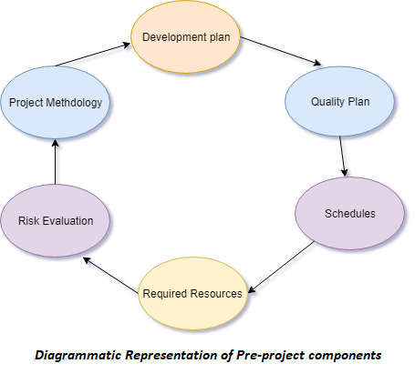
What are Software Quality Assurance components?
1. Pre-project Plan

Slide 10
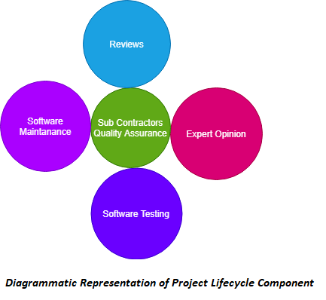
2. Project lifecycle component

Slide 11
3. Infrastructure error prevention and improvement components
The aim of this component is to the prevention of software faults and minimizes the rate of errors.
These components are as:
Procedure and work instructions
Templates and Checklists
Staff Training, Retainin gand Certification
Preventive and Corrective Actions
Configuration Management
Documentation Control
4. Software Quality Management Components
Project Progress Control
Software Quality Metrics
Software Quality Costs

Slide 12
5. Standardization, Certification, and SQA assessment components
Quality management standards
Project process standard
6. Organizing for Software Quality Assurance ? the human elements

Slide 13
How many types of Software Quality Assurance Tools?
Infrastructure
Release Management
Source Control
Code Reviews
Automates Code Analysis
Peer Code Reviews
Testing
Test management
Bug and Issue Tracking
Browser, Device and OS Testing
Usability Testing
Load Testing
Automates Testing and Continuous Integration
Monitoring and Analytics
Availability Monitoring
Business Analytics
Exception Handling
Log Monitoring
Performance Monitoring
Security Testing and Monitoring
Customer Support

Slide 14
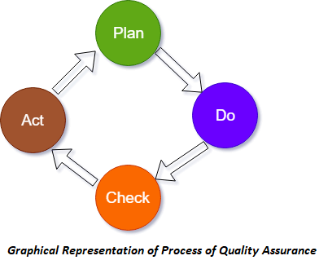
How to do Quality Assurance?

Slide 15
Plan: The organization should plan and establish the process related objectives and determine the process that is required to deliver a high-quality end product.
Do: Development and testing of processes and also change in the methods.
Check: Monitoring of processes, modify the methods, and check whether it meets the predetermined objectives.
Act: Implement actions that are necessary to achieve improvements in the process.

Slide 16
What is Quality Control?
Quality Control popularly abbreviated as QC is a software engineering process used to ensure quality in a product.
It does not deal with the processed used to create a product. Instead, it examines the quality of the end product and the outcome.
The main aim of Quality Control is to check whether the product meets the specification and requirement of the customer. If an issue is identified.

Slide 17
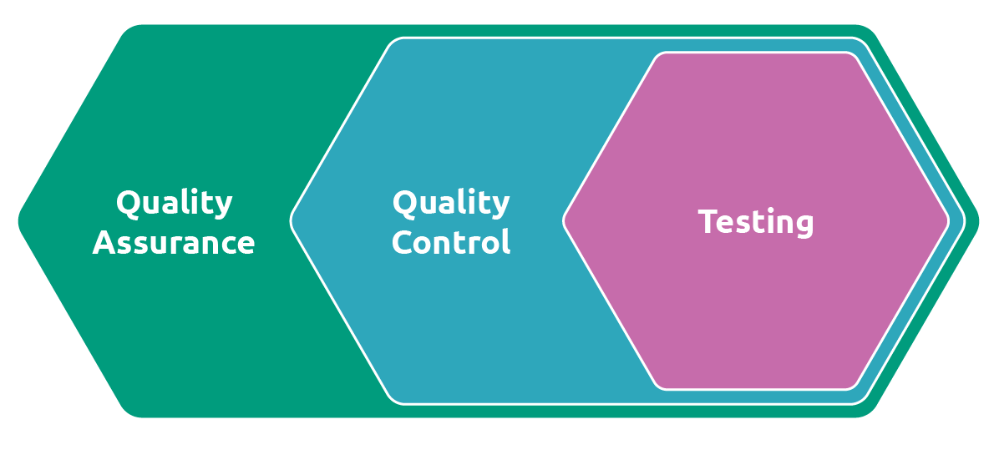

Slide 18
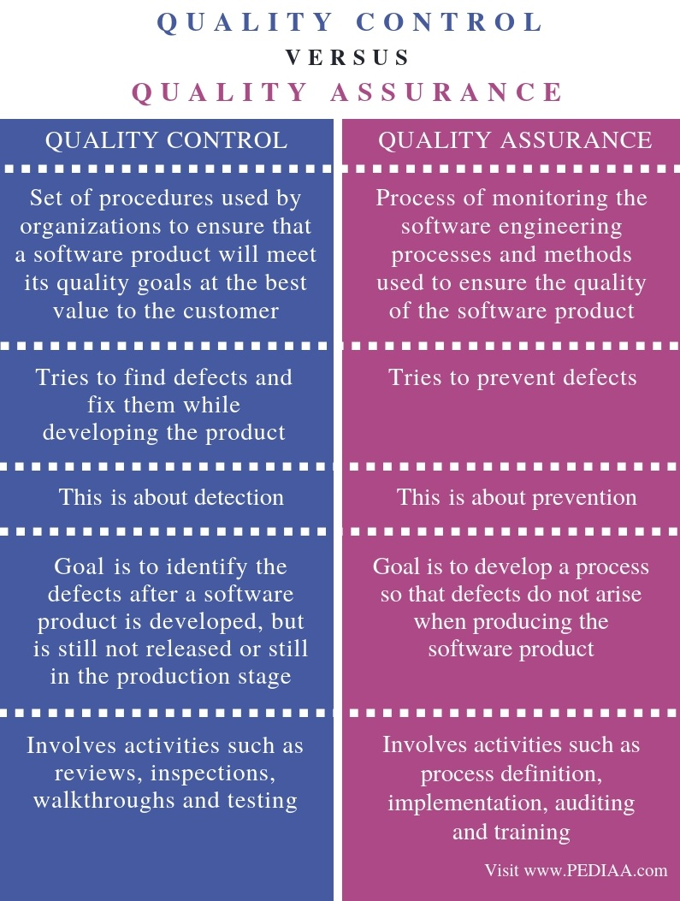
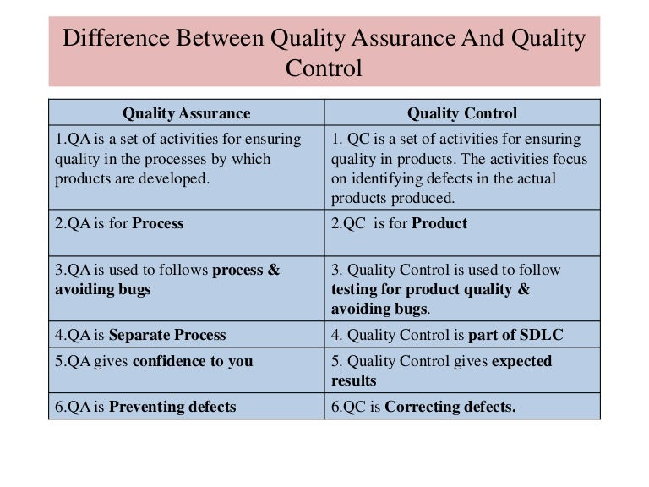

Slide 19
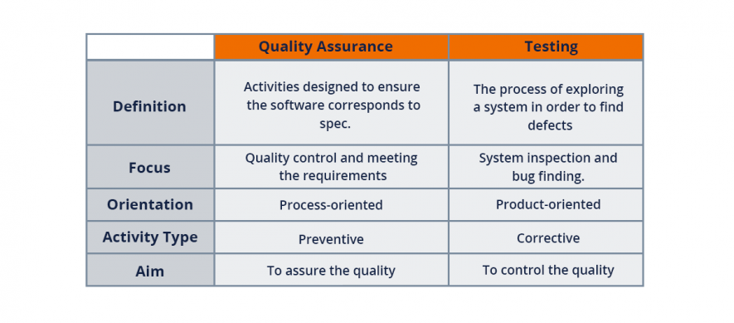

Slide 20
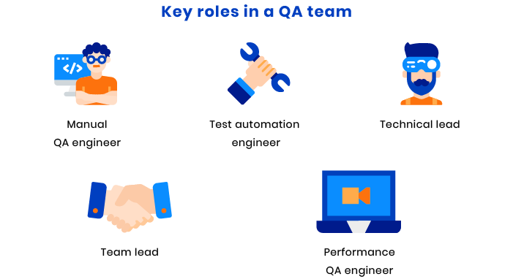
QA role

Slide 21
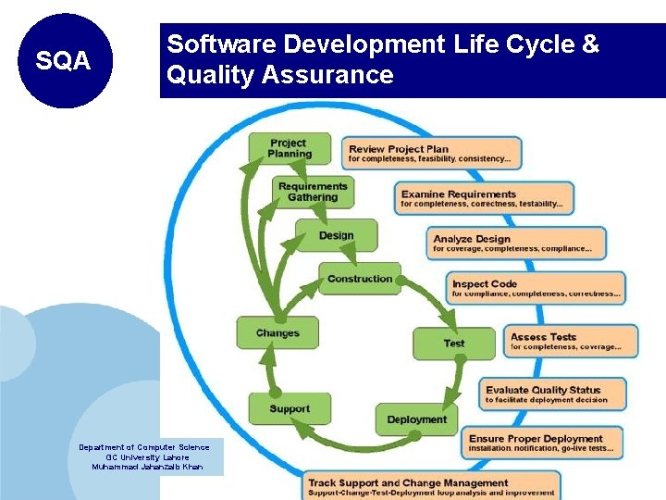

Slide 23
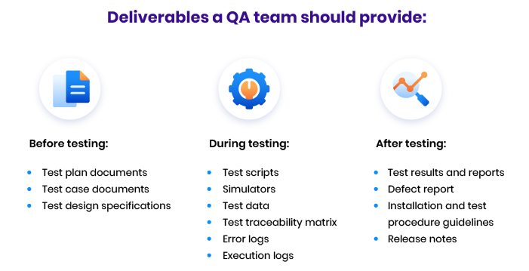
Look into Test Planning

Slide 24
Various kinds of tests QA does

Slide 25
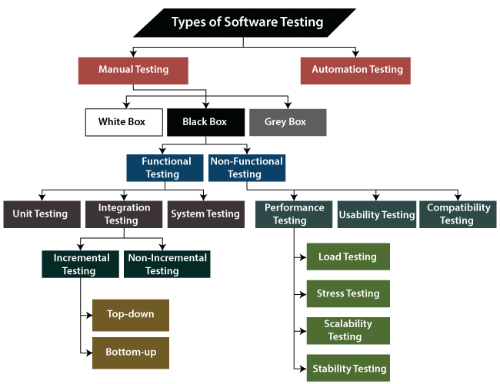

Slide 26
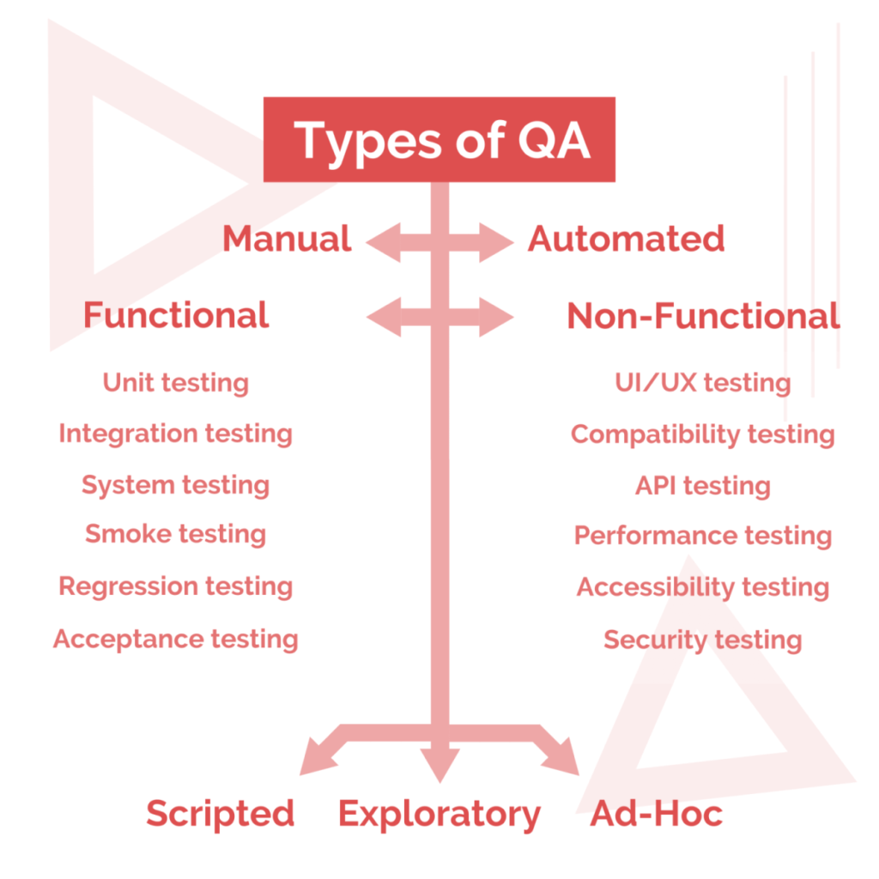

Slide 27
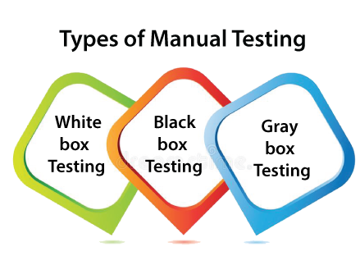
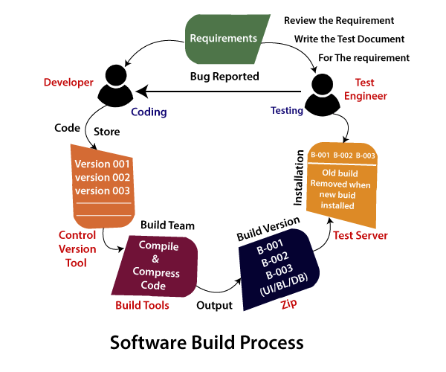
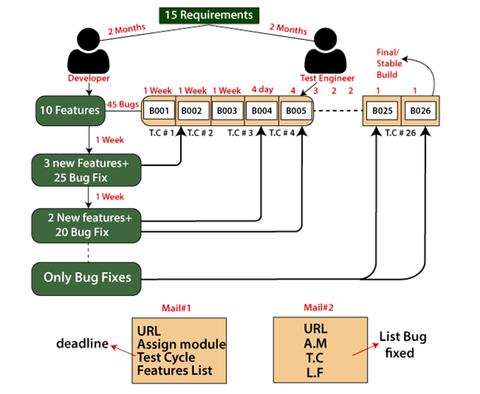

Slide 28
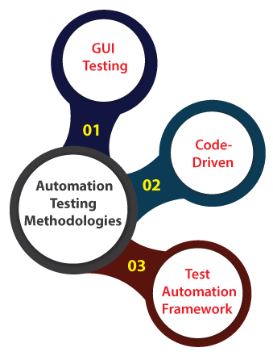
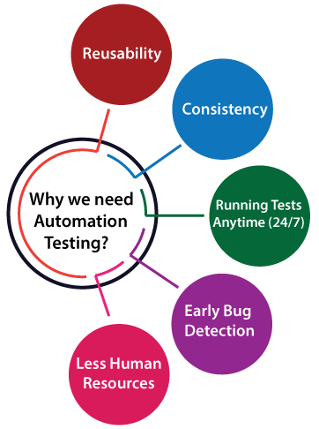
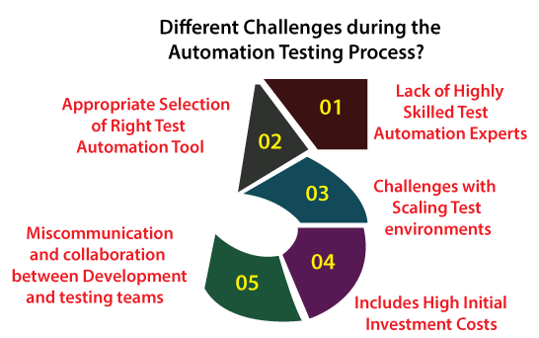
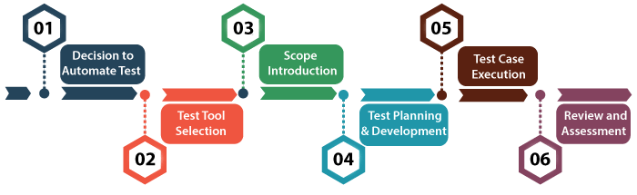

Slide 29
Reporting Bugs

Slide 30
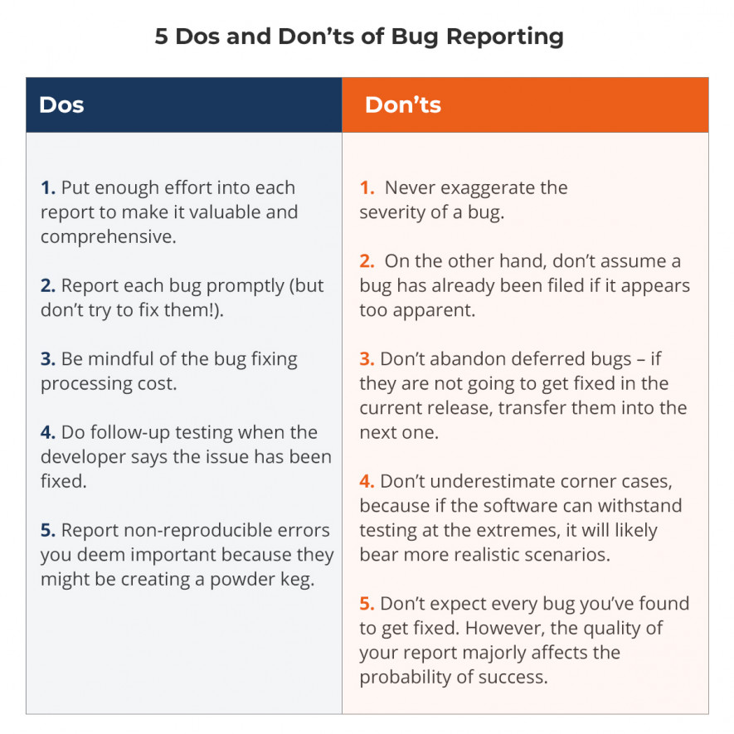

Slide 31
Selenium Testing Tools

Slide 32
Agenda
The Selenium IDE
Selenium IDE Installation and Rules in Creating and Recording Tests
Validating a Test with Assert and Verify
Working with Multiple Windows
Selenium Tests Against AJAX Applications
Parameterization
Locators
Finding Elements by XPath
Finding Elements Using XPath Axis
Finding Elements Using CSS Selectors
Finding Element Using Text and Link Text
Working with Selenium WebDriver
Setting Up Eclipse IDE with Java Project for Selenium WebDriver and TestNG
Working with FirefoxDriver
Working with ChromeDriver
Working with IntenetExplorerDriver

Slide 33
Locating Elements for Test Development with Selenium WebDriver
Finding Element by ClassName and CssSelector
Finding Element by LinkText and PartialLinkText
Finding Element by TagName and XPath
Waiting for Elements to Appear on the Page Design Patterns
Using the Page Factory Selenium Library in Page Objects
Using the Loadable Components Selenium Library
Advanced User Interactions
Mouse Click Events Handling
Action Events to Move Element and Drag-Drop Operations Perform
Context Click and Selecting Multiple Items
Developing Automation Frameworks and Building Utilities
Automation Framework Architecture Design
Automation Framework Structure, Input Data Handler, and Report Logs
Introduction about Web Application Security

Slide 34
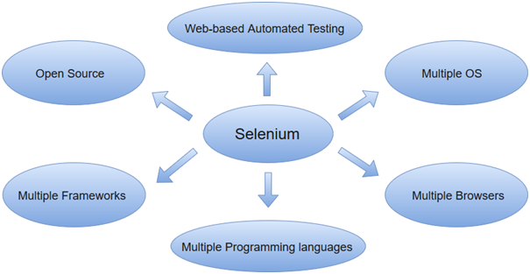
The Selenium IDE
Selenium Integrated Development Environment (IDE) is a Firefox plugin that lets testers to record their actions as they follow the workflow that they need to test.
What is Selenium
Selenium is one of the most widely used open source Web UI (User Interface) automation testing suite. It was originally developed by Jason Huggins in 2004 as an internal tool at Thought Works. Selenium supports automation across different browsers, platforms and programming languages.
It supports automation across different browsers, platforms, and programming languages. Using Selenium, we can automate the functional tests and easily integrate them with Maven, Jenkins, and other build automation and continuous integration tools.

Slide 35
Components of Selenium Suite
Selenium IDE – Selenium IDE is a record and playback automation tool using which we can automate the web applications. It comes in the form of a Chrome and Firefox browser extension. Since it works on the record and playback principle, so it is the first choice automation tool for people with no or limited programming language experience.
Selenium RC – Selenium Remote Control(RC) is officially deprecated by Selenium. It used to inject the javascript code in the browser for automation and required an additional server for running the automation scripts. Apart from this, it had many limitations like – it was slow, it didn’t had a headless browser like HtmlUnitDriver and before executing the test scripts the server was required to be started.
Selenium WebDriver – By far the most important component of Selenium Suite. It provides different drivers for different browsers and supports multiple programming languages. It is purely object-oriented and supports all the major browsers – Chrome, Firefox, IE, Safari, etc and scripting can be done in most of the popular languages – Java, Python, Ruby, etc.
4. Selenium Grid – Selenium Grid is also an important part of the Selenium Suite. It helps in the distributed running of Selenium tests in parallel across multiple remote machines. It has a hub and multiple nodes. The nodes run the Selenium instances on which the test cases are executed. These nodes are connected to a central hub which acts as a server and controls the whole test execution.

Slide 36
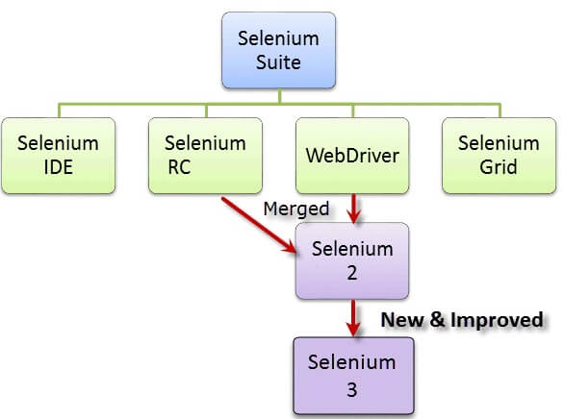

Slide 37
Advantages of Selenium
Selenium is open source, there is no licensing cost for its usage.
Scripting can be done in most of the widely used programming languages like Java, C#, Ruby, and Python.
It provides platform support for all the major operating systems – Windows, Linux, Mac OS, and Solaris.
It supports most of the popular browsers like Chrome, Firefox, Edge, Internet Explorer, Opera, and Safari.
The Selenium IDE component of the Selenium suite provides record and playback features using which non-programmers can also write automation scripts.
Selenium Grid helps in parallel and distributed testing.

Slide 38
Limitations of Selenium
Selenium does not provide desktop application automation support.
Web Services – REST or SOAP cannot be automated using Selenium.
Selenium WebDriver requires programming language requirements for script creation.
For performing common tasks required in automation like logging, reading-writing to external files, we have to rely on external libraries.

Slide 39
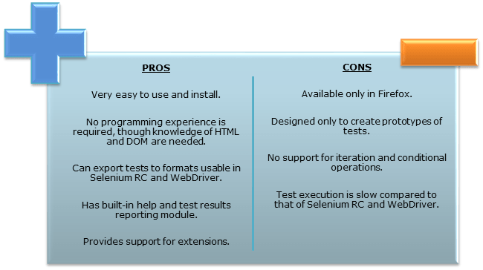
Selenium IDE

Slide 40
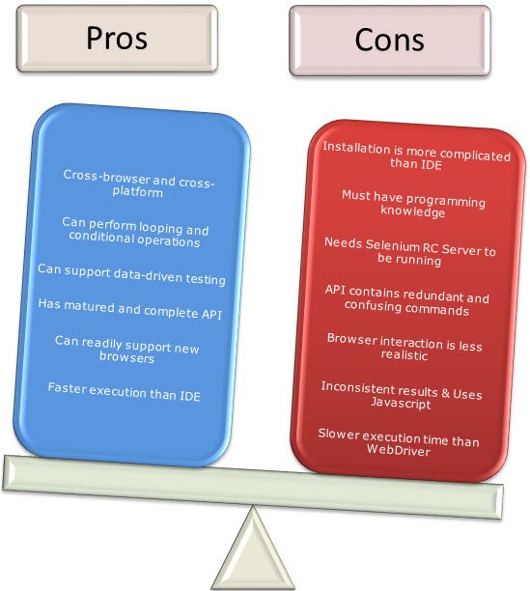
Selenium Remote Control (Selenium RC)

Slide 41
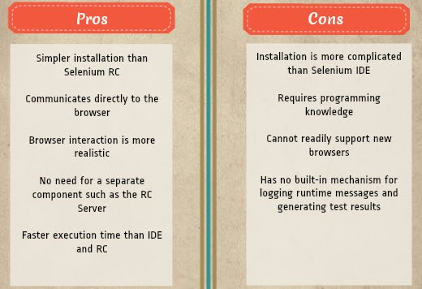
Selenium WebDriver

Slide 42
Locators
What are Locators?
Locator is a command that tells Selenium IDE which GUI elements ( say Text Box, Buttons, Check Boxes etc) its needs to operate on. Identification of correct GUI elements is a prerequisite to creating an automation script.
But accurate identification of GUI elements is more difficult than it sounds. Sometimes, you end up working with incorrect GUI elements or no elements at all! Hence, Selenium provides a number of Locators to precisely locate a GUI element

Slide 43
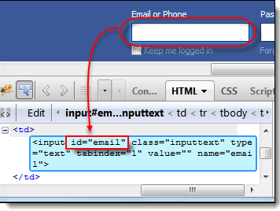
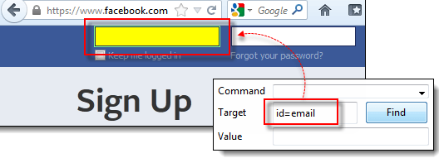
Locating by ID
This is the most common way of locating elements since ID’s are supposed to be unique for each element.
Target Format: id=id of the element

Slide 44
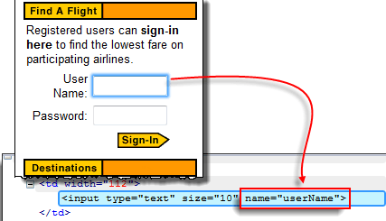
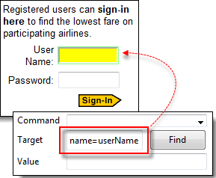
Locating by Name
Locating elements by name are very similar to locating by ID, except that we use the “name=” prefix instead.
Target Format: name=name of the element

Slide 45
How To Locate Element By Name using Filters
Filters can be used when multiple elements have the same name. Filters are additional attributes used to distinguish elements with the same name.
Target Format: name=name_of_the_element filter=value_of_filter

Slide 46
Locating by CSS Selector
CSS Selectors in Selenium are string patterns used to identify an element based on a combination of HTML tag, id, class, and attributes. Locating by CSS Selectors in Selenium is more complicated than the previous methods, but it is the most common locating strategy of advanced Selenium users because it can access even those elements that have no ID or name.
CSS Selectors in Selenium have many formats, but we will only focus on the most common ones.
Tag and ID
Tag and class
Tag and attribute
Tag, class, and attribute
Inner text

Slide 47
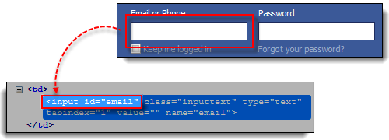
Locating by CSS Selector – Tag and ID
Again, we will use Facebook’s Email text box in this example. As you can remember, it has an ID of “email,” and we have already accessed it in the “Locating by ID” section. This time, we will use a Selenium CSS Selector with ID in accessing that very same element.
css=tag#id | tag = the HTML tag of the element being accessed # = the hash sign. This should always be present when using a Selenium CSS Selector with ID id = the ID of the element being accessed

Slide 48
Locating by CSS Selector – Tag and Attribute
This strategy uses the HTML tag and a specific attribute of the element to be accessed.
ss=tag[attribute=value] | tag = the HTML tag of the element being accessed [ and ] = square brackets within which a specific attribute and its corresponding value will be placed attribute = the attribute to be used. It is advisable to use an attribute that is unique to the element such as a name or ID. value = the corresponding value of the chosen attribute.

Slide 49
Locating by DOM (Document Object Model)
The Document Object Model (DOM), in simple terms, is the way by which HTML elements are structured. Selenium IDE is able to use the DOM in accessing page elements. If we use this method, our Target box will always start with “dom=document…”; however, the “dom=” prefix is normally removed because Selenium IDE is able to automatically interpret anything that starts with the keyword “document” to be a path within the DOM in Selenium anyway.
There are four basic ways to locate an element through DOM in Selenium:
getElementById
getElementsByName
dom:name (applies only to elements within a named form)
dom:index

Slide 50
Working with Selenium WebDriver

